Slide 1
Title:
Chocolate Sale Report
Subtitle:
Visual Analytics Dashboard

Slide 2
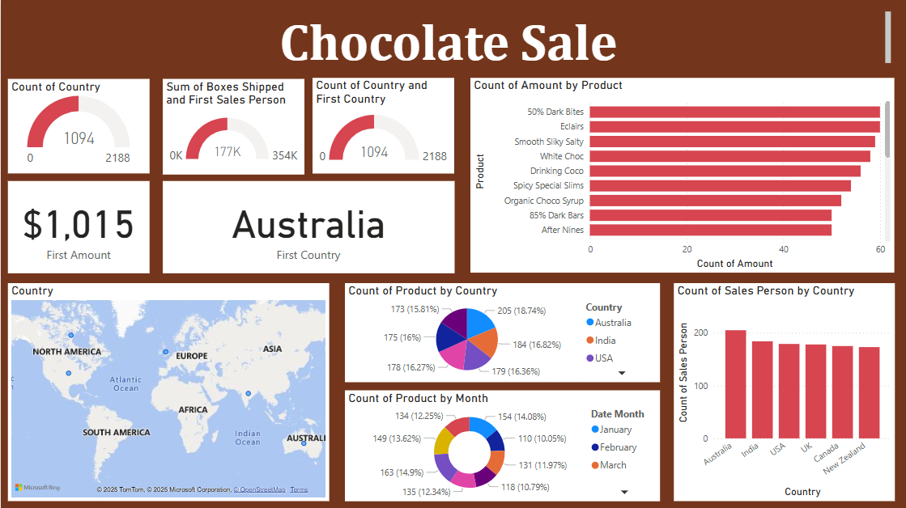

Slide 3
Overview:
The dashboard provides insights into chocolate sales across various countries and months.
Key metrics include sales count, shipment volume, first transaction details, and product popularity.
Comparative analytics for products, countries, and sales personnel.
Key Metrics:
Total Countries Involved: 2,188
Sales Sample Shown: 1,094 Countries
First Sale Amount: $1,015
First Country of Sale: Australia
Boxes Shipped (First Sales Person): 177K out of 354K

Slide 4
Product Performance:
Top Selling Products:
50% Dark Bites, Eclairs, Smooth Silky Salty, White Choc, Drinking Coco
Least Sold Product:
After Nines
Country-Wise Sales:
Top Countries by Product Sales Count:
Australia: 205 (18.74%)
India: 184 (16.82%)
USA: 179 (16.36%)
Other Countries: Each ~15–16% sales count

Slide 5
Sales by Month:
January: 154 (14.08%)
February: 134 (12.52%)
March: 131 (11.97%)
Most Active Month: January
Sales Spread is relatively balanced across months
Sales Team Distribution:
Highest Sales Personnel Count: Australia
Other Countries:
India, USA, UK, Canada, New Zealand have similar distribution
Indicates even spread of workforce globally

Slide 6
Geographical Reach:
Sales span across North America, Europe, Africa, Asia, and Australia
First transaction started in Australia
Global coverage shows chocolate sale as a worldwide operation
Conclusion:
Australia leads in early and high sales volume
50% Dark Bites are the most popular product
Sales are consistent across months and regions
Opportunity for expansion in underperforming regions/products

